Slide 1


EDA#VECELK PROJECT
Data Analytics - A.Y. 2021-22
Application and API Service for semantic search over large document collections
through Haystack and vector database Elasticsearch.
Students
Damiano Serpetta
Rizoanun Nasa

Slide 2
Introduction & OBJECTIVES
Application prototype for the purpose of doing semantic search over large document collections by using NLP Models and Search engine system.
Objectives:
Study new way to extract information from data.
Apply NLP Models in a Search Engine environment in order to do semantic search over syntactic search.
Implement system in a website context.
Build a prototype of all parts working together.
Test system environment.

Slide 3
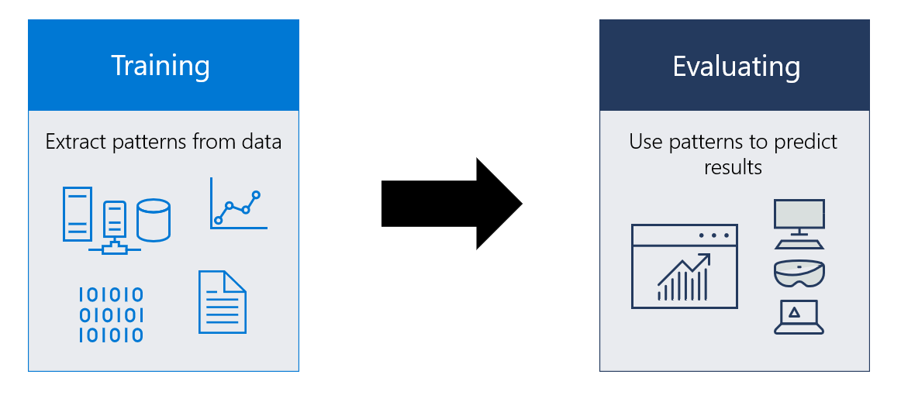
Natural language processing
Natural Language Processing is machine learning technique where human language is separated into fragments so that the grammatical structure of sentences and the meaning of words can be analyzed and understood in context. This helps computers read and understand spoken or written text in the same way as humans.
NLP Model used in the project is RoBERTa (Robustly Optimized BERT Pretraining Approach), pre-trained on SQuAD (Stanford Question Answering Dataset). RoBERTa is based on Transformers Neural Network.
Different models can be used, such as ALBERT, XLNet, OpenAI’s GPT-3 …

Slide 4
Natural language processing
NLP Models are used in the prototype, in combination with Elastic Search Engine, to understanding meaning of words and sentences in documents as well as asked questions.
Search process will be made based on text semantic, i.e. meaning of texts and words.
Models can be trained by yourself and they can be fine-tuned for domain-specific purposes.
USAGE AND OPTIMIZATIONS

Slide 5

Elasticsearch
Elasticsearch is a distributed search engine for all types of data, including textual, numerical, geospatial, structured, and unstructured.
Document Based.
De-normalization and reverse indexing, searching improvements and better execution..
Data Ingestion, process by which this raw data is parsed, normalized, and enriched before it is indexed in Elasticsearch.
Elastic Search can be accessed by API or a visualization tool like Kibana.

Slide 6
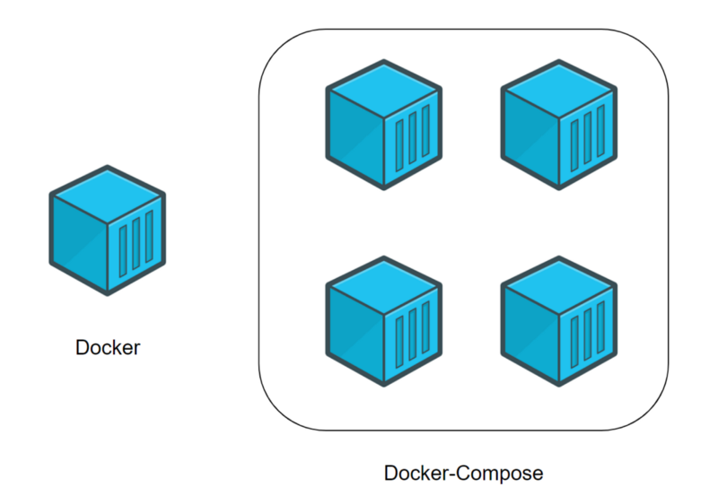
ELASTICSEARCH & KIBANA
Visualization of data over Elastic Search is provided by Kibana, which allows users to create powerful visualizations of their data, share dashboards, and manage the Elastic Stack.
Elasticsearch and Kibana execution is containerized and isolated by using Docker Compose.

Slide 7
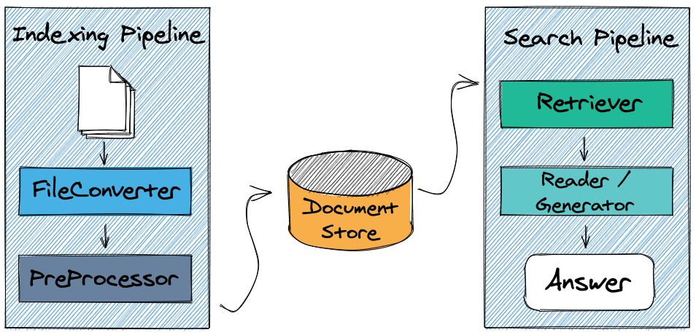
haystack
Haystack is an open-source framework for building search systems that work through words and sentences' semantic similarities over large document collections.
His functionalities are built using NLP Models, capable of understanding natural human language and perform searches by semantic similarities.
Haystack provides a Python library for building an Question & Answer System, on top of Elastic Search (or even other engine).
His core are made of nodes, to process information, data, queries, answers, and pipelines, to envelop nodes in defined processes to obtain an result.

Slide 8
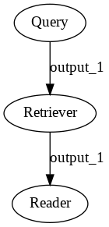
Haystack pipelines
Haystack pipelines are the keys of the framework.
The core idea is to build a Directed Acyclic Graph (DAG) where each Node is one building block of Q&A System (Reader, Retriever, Generator).
Pipeline used in this prototype is composed by following nodes:
Reader, lightweight filter that can quickly go through the full document store and pass on a set of candidate documents that are relevant to the query.
Retriever, also known as Open-Domain QA systems in Machine Learning speak, is the core component that enables Haystack to find the answers.

Slide 9
crawler
Crawler is a haystack module who permits the extraction of text data from a website and nested pages contained.
Crawler component crawl URL(s), extract the text from the website, create a Haystack Document object out of it and save it (one JSON file per URL), including text and basic meta data. Filter Urls can be specified to only crawl URLs that match a certain pattern.
The module make use of chrome-driver for the process of data extraction from website.

Slide 10

Pre-processing
Pre-processing nodes in haystack is responsible to clean texts incoming to application.
Cleaning text process comes with removing white spaces, empty lines, header and footer and splitting sentence.
Focus on store document as clean as possible.
Application apis
API Service is developed by using FASTApi framework for Python, which works as controller for the application.
API Service starts in localhost and remains listening for requests on port 5000 (configurable).
Requests and responses are made through HTTP and the data exchanged is in JSON format, following the schema classes type.

Slide 11




PROTOTYPE SYSTEM
Prototype system is written in Python from scratch, built on top of discussed components.
The combination of Elastic Search, Haystack and NLP Models results in a complex and powerful search engine system over unstructured data crawled from external sources.
In addition, it expose REST API to the Web, for the interaction with the users.

Slide 12
System Configuration
The application follows hardware requirements of Haystack and Elasticsearch, because due to indexing, documents processing, filtering and searching with NLP (Natural Language Processing) Models, it needs at least 8-16GB RAM and a powerful CPU like the one described below in Configuration chapter.
The application is compatible with Linux, Windows and MacOS. However, each OS requires his own measures to make the system work properly.
USED CONFIGURATION
MACHINE | Azure VM Standard D4s v3
CPU | Intel Xeon E5-2673 v4 (4 vCPUs)
RAM | 16GB
GPU | No
STORAGE | 128GB

Slide 13
System demonstration
starting

Slide 14
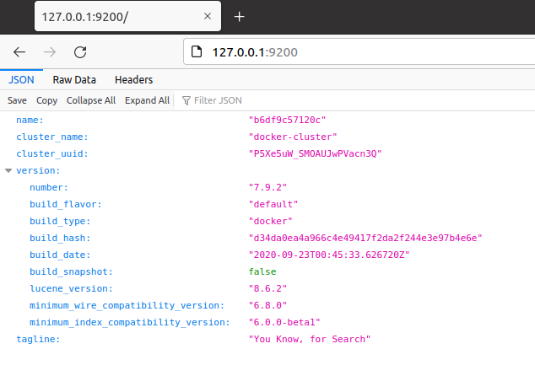
elasticsearch and kibana
Start Elasticsearch and Kibana with Docker Compose with pre-configured YAML file.

Slide 15
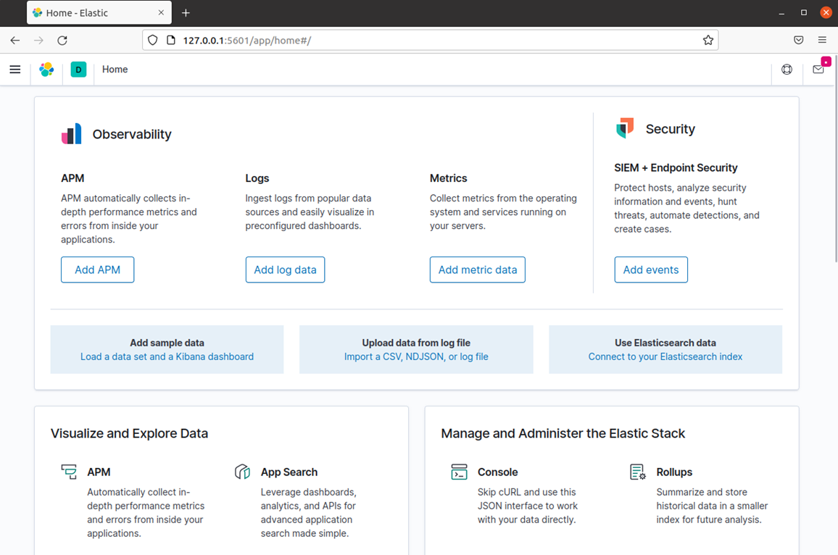
Kibana visualization

Slide 16
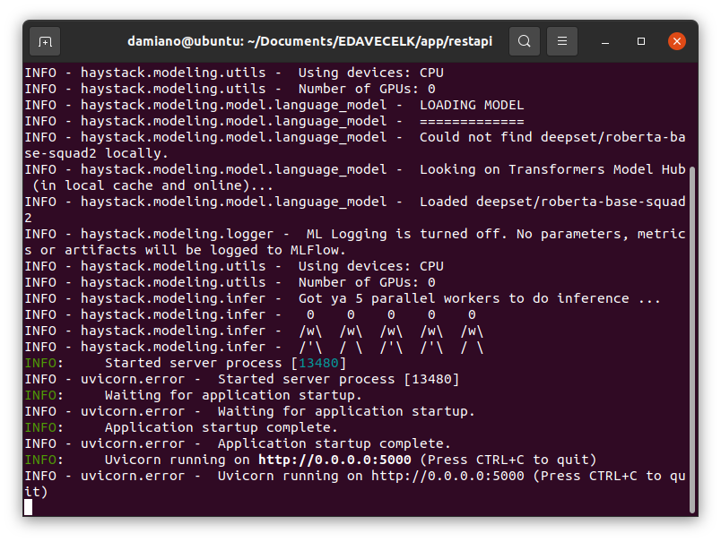
Starting application
Application will start loading NLP Models from cache or online repository.
After NLP Models loading, web server will start and remain listening on the specified port.

Slide 17
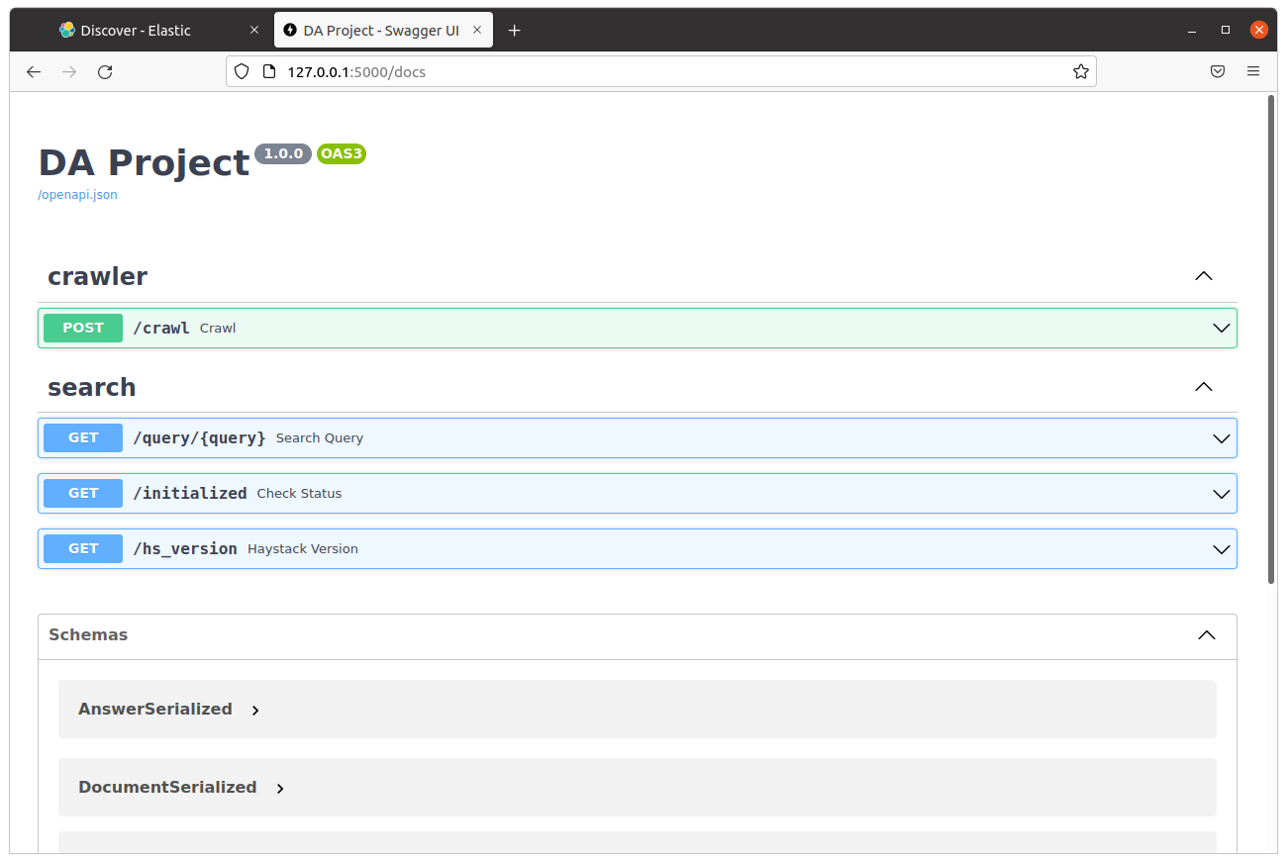
Web server api
Application provides a web service with API Endpoints where user can interact with his functions by making HTTP Requests.

Slide 18
System demonstration
usage

Slide 19
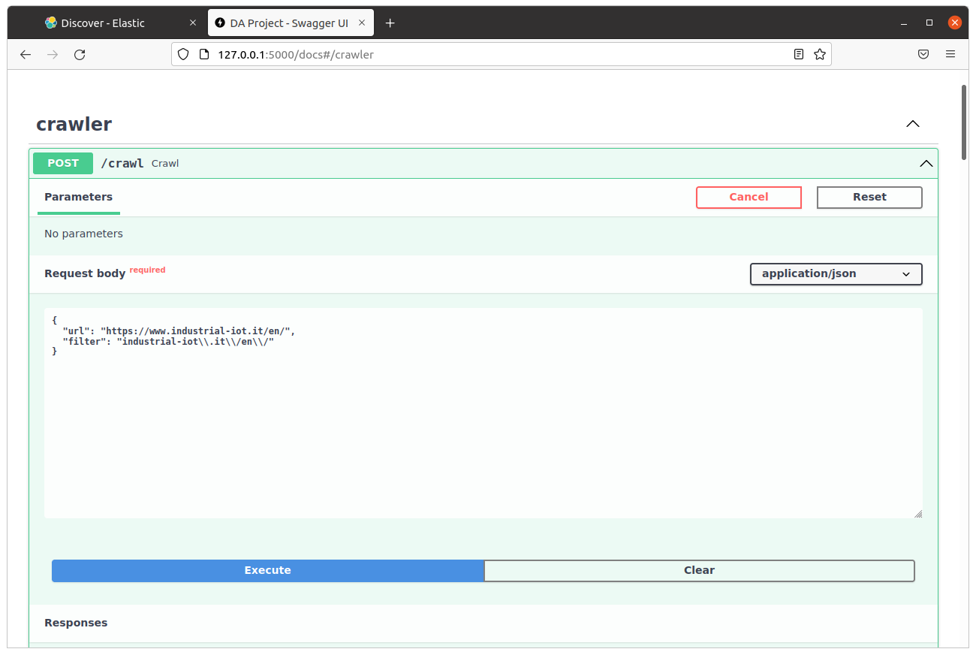
Crawling Website
Crawling website procedure can be made by requesting /crawl API Endpoint, specifying url and url filter.
The result of web crawling will be a series of JSON Documents that will be converted in dictionaries and ingested in Document Store (Elastic Search).
After the ingestion, the system will be ready to search above the document.

Slide 20
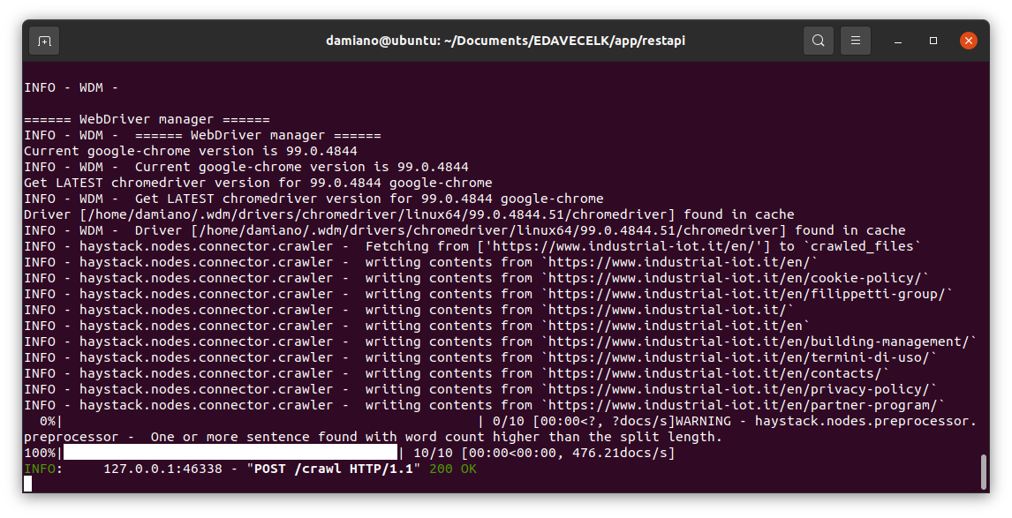
crawling
Crawling process logs in application.

Slide 21
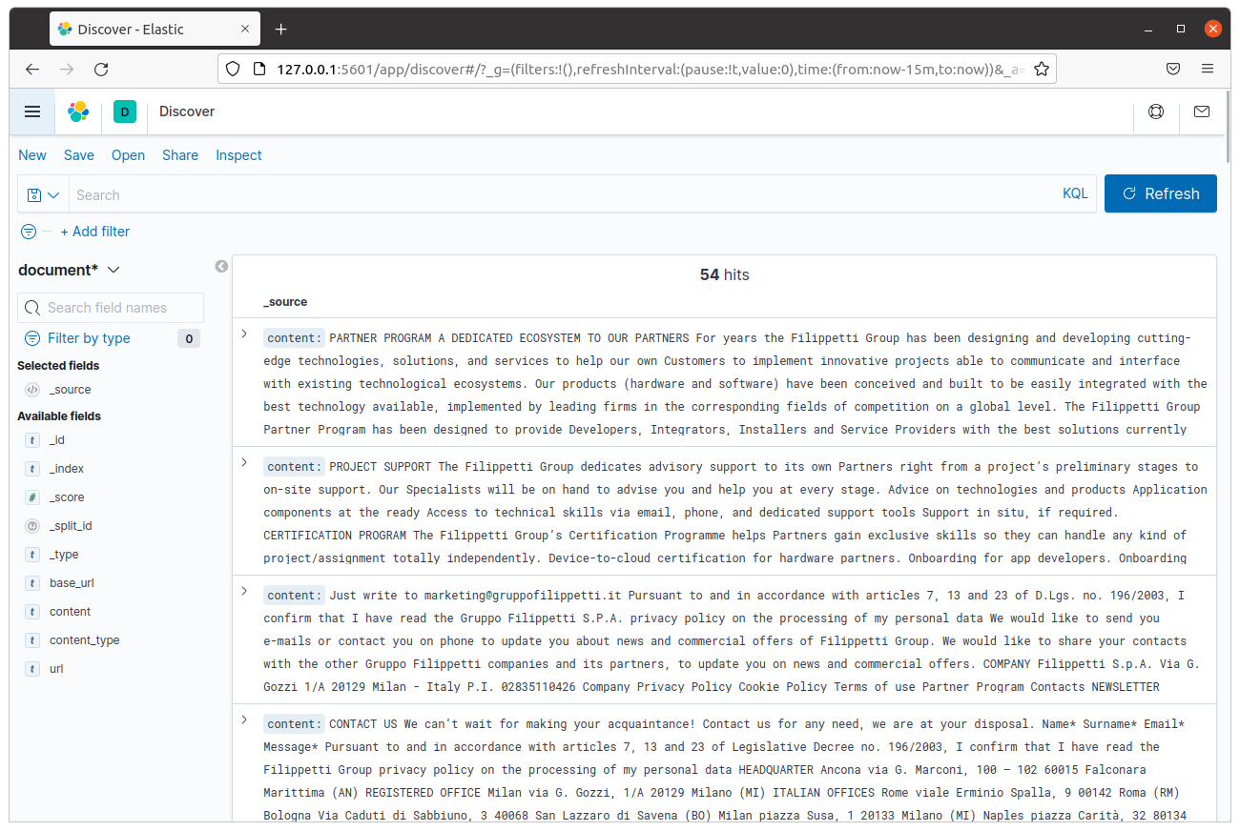
Crawled data visualization in kibana

Slide 22
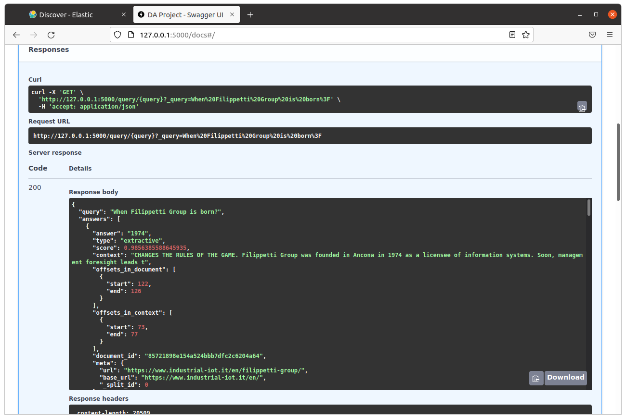
Querying system
Querying system is made with /query endpoint, specifying query to be done.
Results of query will be a JSON Object with some properties:
Given query, answers, score of reliability, context, offset in document/context, metadata of the document.
Query system works better with questions instead of single keyword.

Slide 23
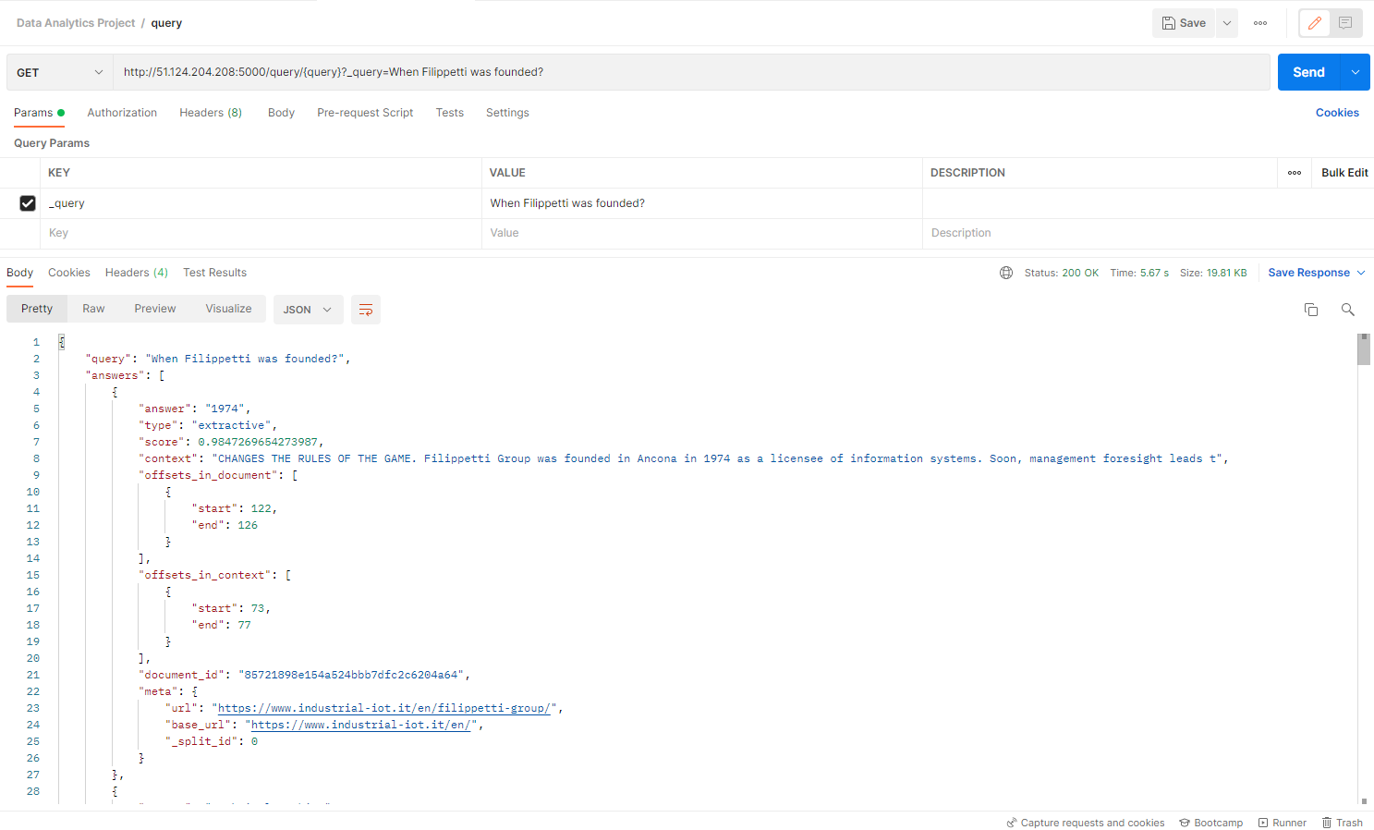
Other tries
Query: ‘When Filippetti was founded?’
Answer: ‘1974’

Slide 24

Other tries
Query: ‘What the Atex PPE does?’
Answer: ‘SAVING LIFE TO PEOPLE’

Slide 25
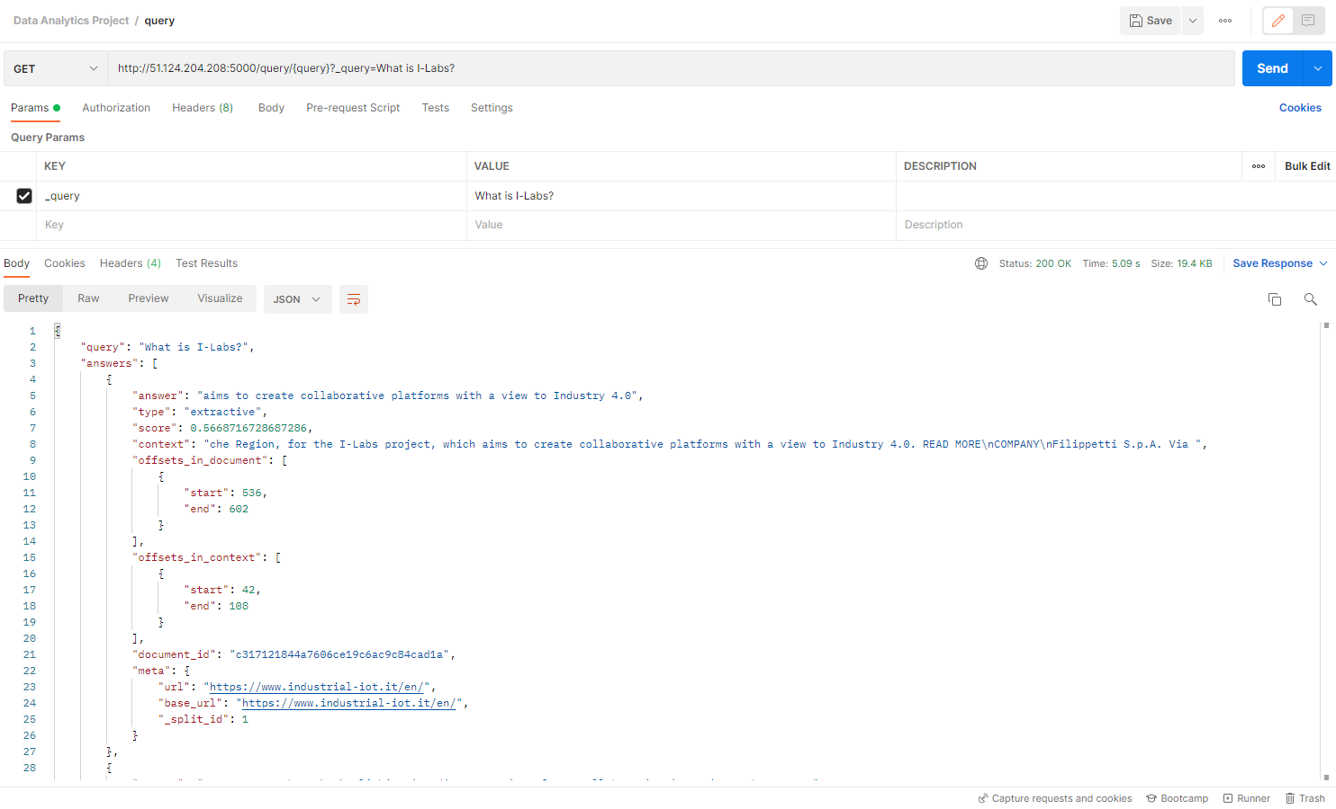
Other tries
Query: ‘What is I-Labs?’
Answer: ‘aims to create collaborative platforms with a view to Industry 4.0’

Slide 26
conclusions
Answers retrieved from Haystack in most cases meets our expectations and level of reliability of them.
Haystack needs large datasets to work properly and to retrieve better answers related to questions.
In test environment, we tried with dataset crawled from www.industrial-iot.it/en/ and ask some questions to the system: also if dataset is not so large, answer retrieval process works fine in that context.
We can distinguish answers reliability in some factors:
Right Answer
Right Context
Wrong Context
Wrong answer
Right Context
Wrong Context

Slide 27
Future Improvements
Fine tuning Machine Learning Models is important to retrieve better results also to specific environment and user requirements.
Crawling websites could be more accurate, in particular Crawler component doesn't filter by type of content on website: For example, Privacy and Cookie Policy description can be deleted from the website.
Authentication can be implemented to REST API Service: one idea can be implement Json Web Token (JWT) and develop a token-based security mechanism.
Lastly, it would be interesting to study and to do a research for usages in real world use cases.

Slide 28
thanks
Do you have any questions?

